Slide 1

Dark Wolf Hack Our Drone
Communications

Slide 2







UAS OV1
Radio Interfaces
Telemetry / C2
RC / Radio Controller
Payload Data
GPS
ADS-B
DroneID
GPS
ADS-B
RF
Wifi
Supply Chain
RF
Wifi
Software Libraries

Slide 3
RF Communication: Two Broad Categories
Radio Transmission
Freqs - Regulated, Varies by Country and Region
315 MHz
433 MHz
868 MHz
915 MHz
2.4 GHz
Encodings
NRZ
Manchester
Modulations
ASK (AM)
FSM (FM)
PSK
QAM
802.11 Wireless LAN
2.4 GHz / 5 GHz
Tends to emphasize bandwidth over range
Wider bandwidth increase data transfer rates
Narrow bandwidth increases effective range
802.11n - 20,40,80 MHz bandwidths
802.11n - also 10,5 MHz bandwidths
MikroTik provides even narrower and 5MHz increments
802.15.1 Bluetooth
ITU-T Y.4480 LoRa / LoRaWAN

Slide 4
Radio Transmission

Slide 5

RF Transceiver
Binary
Data
Frame
Encode
Modulate
Binary
Data
Deframe
Decode
Demod

Slide 6
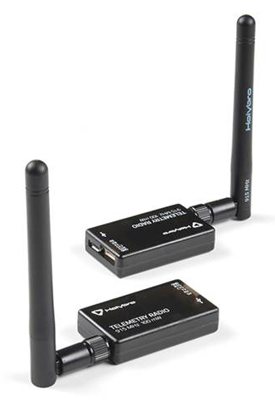
RF Radio Products
Silicon Labs si1000 (SiK)
Microhard Radios
Doodle Labs

Slide 7

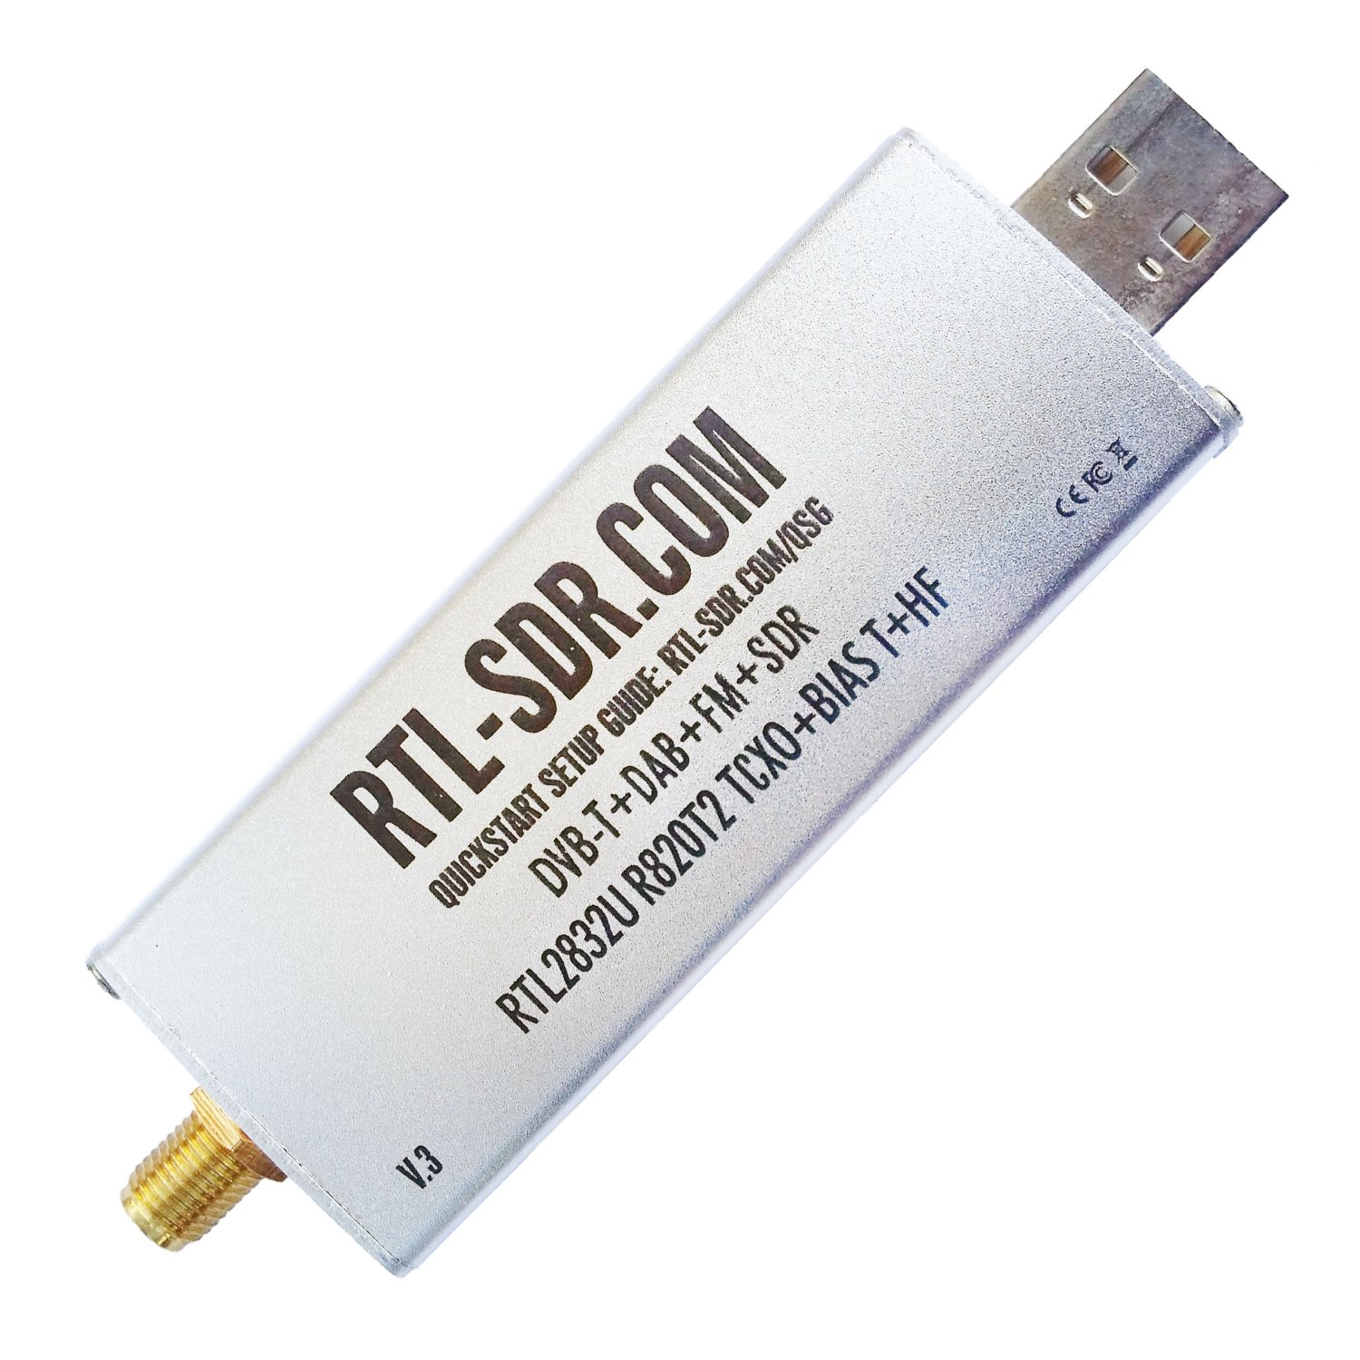
HW Tools for RF Cyber Testing

Slide 8
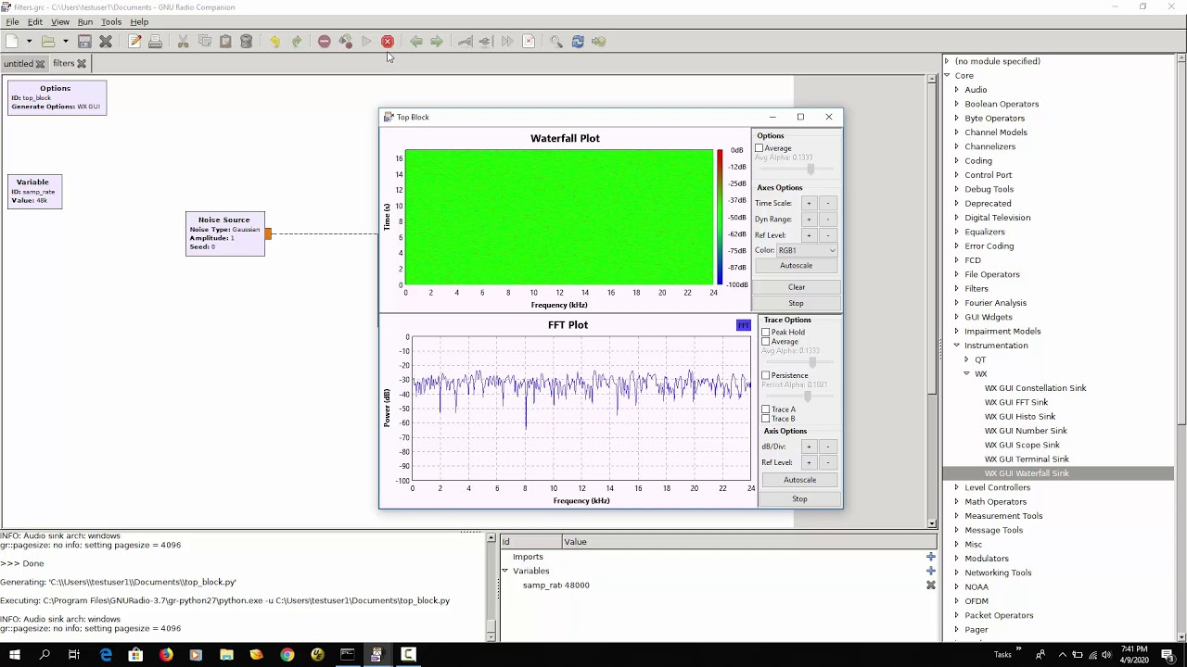
SW Tools for RF Testing: GNU Radio Companion

Slide 9
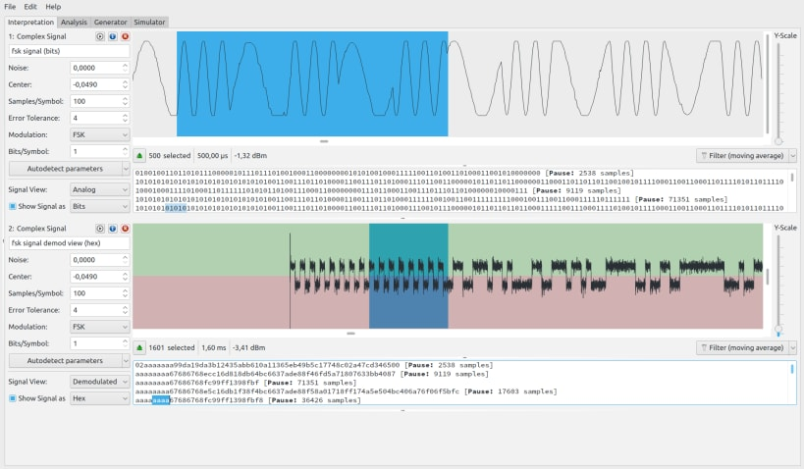
SW Tools for RF Testings: Universal Radio Hacker

Slide 10
WiFi - Wireless LAN
(and related technologies)

Slide 11
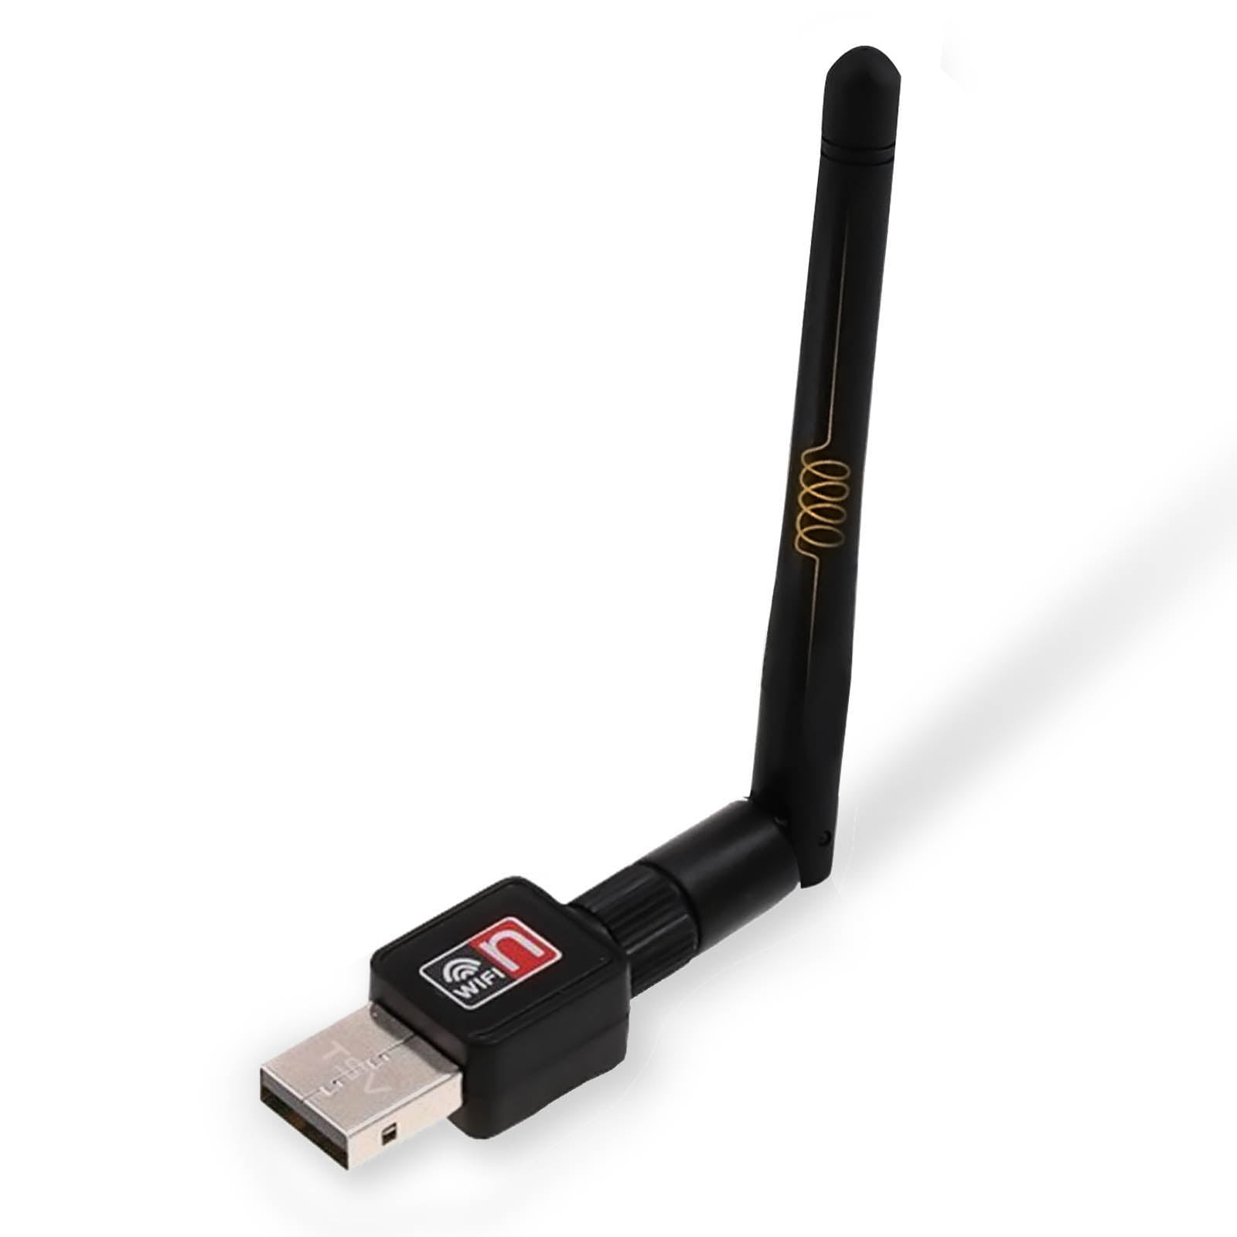
WiFi Products
Ubiquitous
Built into many Single Board Computers
Speciality Products for Longer Range

Slide 12
OSI and 802.11
7. Application
6. Presentation
5. Session
4. Transport
3. Network
2. Data Link
1. Physical
802.11 elements map to first two layers
Physical (PHY)
Medium Access Control (MAC)
802.2 Logical Link Control (LLC)
802.3
Ethernet
802.4
Token Bus
802.5
Token Ring
802.11
Wireless LAN
https://www.grandmetric.com/wp-content/uploads/2018/12/80211-osi-model.jpg

Slide 13
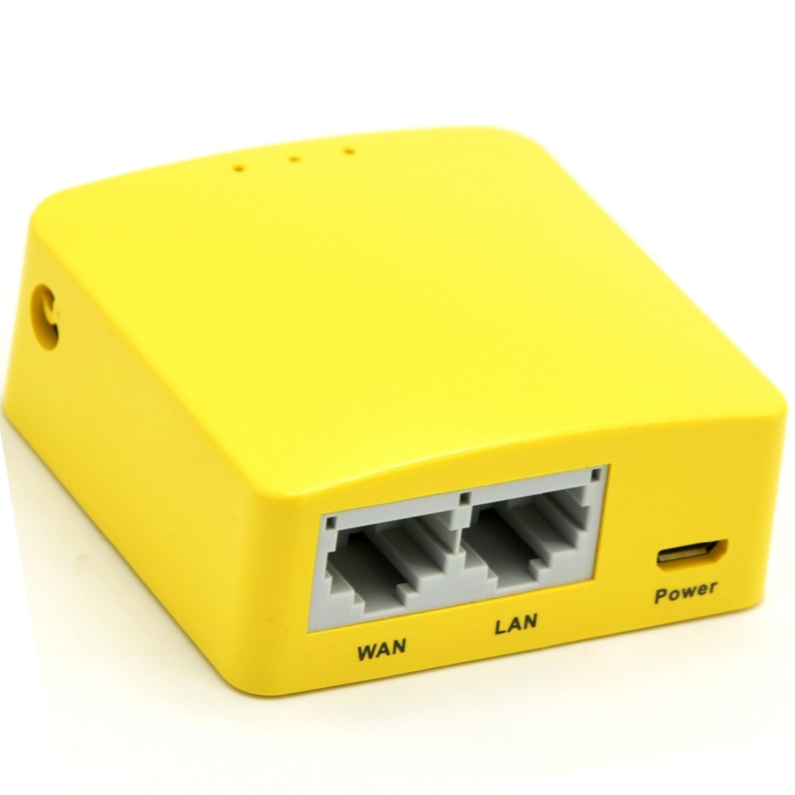
HW Tools for RF Cyber Testing

Slide 14
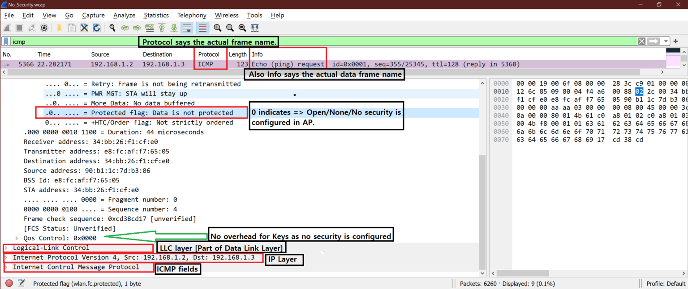
SW Tools for RF Testing: Wireshark
https://wifisharks.com/2021/01/17/how-to-decrypt-the-802-11-encrypted-packets-using-wireshark/

Slide 15
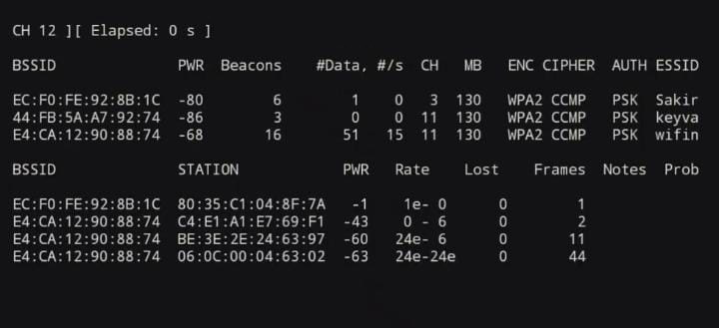
SW Tools for RF Testing: Aircrack-ng
https://www.geeksforgeeks.org/how-to-use-aircrack-ng-in-termux/

Slide 16
UAS Communications
Lab Overview

Slide 17
Hack Our Drone: Comms Lab Task List
Capture 802.11 Network Traffic
airodump-ng
View 802.11 Network Traffic
Wireshark
802.11 traffic
MAVlink data
Crack 802.11 WPA2 Passphrase
aircrack-ng

